Slide 1
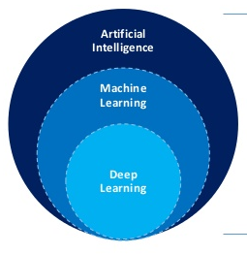
Machine Learning is a type of AI

Slide 2
AI is more than Machine Learning

Slide 3
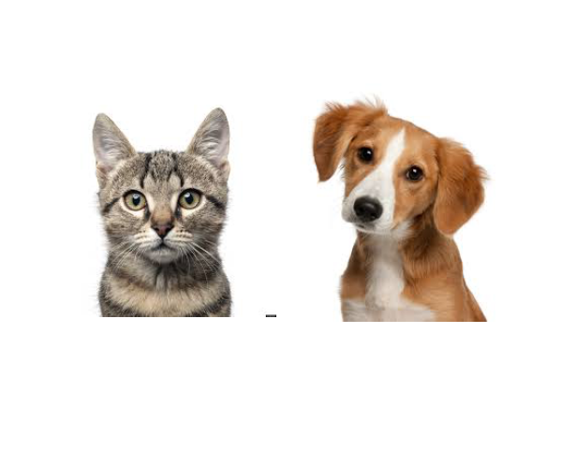
Traditional Software Development

Slide 4
Traditional Software Development
Input:
Rules:
Output:

Slide 5
Traditional Software Development
Input:
Rules: rule 1
rule 2
rule 3 …
Output:

Slide 6
Traditional Software Development
Input:
Rules: rule 1
rule 2
rule 3 …
Output: “cat”

Slide 7
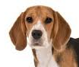



Machine Learning
Input:[ , , , ]
Relationship:
Output: [“cat”, “dog”, “dog”, “cat]

Slide 8

Machine Learning
Input:[ , , , ]
Relationship:
Output: [“cat”, “dog”, “dog”, “cat]

Slide 9
Common ML Algorithms
Linear Regression
Logistic Regression
Support Vector Machine
Decision Tree
K-Nearest Neighbor
Neural Network
=

Slide 10
Machine Learning
Input:[ , , , ]
Relationship:
Output: [“cat”, “dog”, “dog”, “cat]

Slide 11

Machine Learning
Input:[ , , , ]
Relationship:
MODEL
Output: [“cat”, “dog”, “dog”, “cat]

Slide 12
Machine Learning
input *1.8 + 32
MODEL

Slide 13

Machine Learning
input *1.8 + 32
MODEL

Slide 14
Machine Learning
input *1.8 + 32
output: ‘Cat’
MODEL

Slide 15

DATA
ALGORITHM
MODEL

Slide 16

DATA
ALGORITHM
MODEL
NEW DATA
MODEL
PREDICTIONS

Slide 17
Evaluate the Model

Slide 18
Evaluate the Model
Training Data
Test Data

Slide 19
Train

Slide 20
Train
Test

Slide 21
Train
Test
Deploy

Slide 22
Computer Vision

Slide 23
Neural Networks

Slide 24
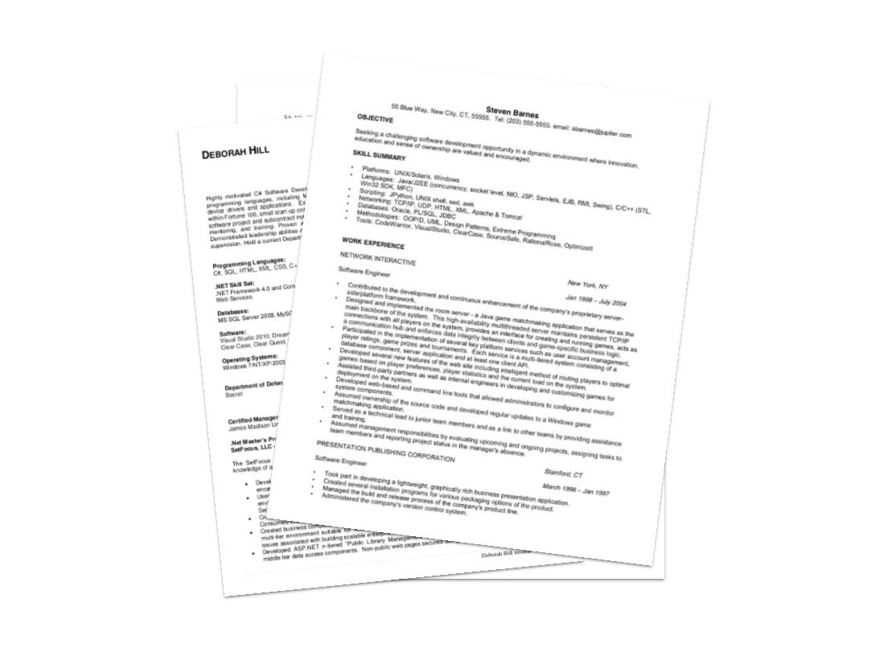

Slide 25
Data
Gender | Experience (yrs.) | Phone Interview | Previous Employer | Onsite Interview
Male | 3 | 7 | 4 | Yes
Female | 1 | 7 | 2 | No
Female | 7 | 9 | 3 | Yes
Male | 4 | 6 | 2 | No
Female | 3 | 8 | 3 | Yes

Slide 26
Data
Gender | Experience (yrs.) | Phone Interview | Previous Employer | Onsite Interview
0 | 3 | 7 | 4 | Yes
1 | 1 | 7 | 2 | No
1 | 7 | 9 | 3 | Yes
0 | 4 | 6 | 2 | No
1 | 3 | 8 | 3 | Yes

Slide 27
Data
Gender | Experience (yrs.) | Phone Interview | Previous Employer | Onsite Interview
0 | 3 | 7 | 4 | 1
1 | 1 | 7 | 2 | 0
1 | 7 | 9 | 3 | 1
0 | 4 | 6 | 2 | 0
1 | 3 | 8 | 3 | 1

Slide 28
Data
Features
Gender | Experience (yrs.) | Phone Interview | Previous Employer | Onsite Interview
0 | 3 | 7 | 4 | 1
1 | 1 | 7 | 2 | 0
1 | 7 | 9 | 3 | 1
0 | 4 | 6 | 2 | 0
1 | 3 | 8 | 3 | 1

Slide 29
Data
Gender | Experience (yrs.) | Phone Interview | Previous Employer | Onsite Interview
0 | 3 | 7 | 4 | 1
1 | 1 | 7 | 2 | 0
1 | 7 | 9 | 3 | 1
0 | 4 | 6 | 2 | 0
1 | 3 | 8 | 3 | 1
Target

Slide 30
Data
Gender | Experience (yrs.) | Phone Interview | Previous Employer | Onsite Interview
0 | 3 | 7 | 4 | 1
1 | 1 | 7 | 2 | 0
1 | 7 | 9 | 3 | 1
0 | 4 | 6 | 2 | 0
1 | 3 | 8 | 3 | 1
Labels

Slide 31
Data
Gender | Experience (yrs.) | Phone Interview | Previous Employer | Onsite Interview
0 | 3 | 7 | 4 | 1
1 | 1 | 7 | 2 | 0
1 | 7 | 9 | 3 | 1
0 | 4 | 6 | 2 | 0
1 | 3 | 8 | 3 | 1
Sample

Slide 32
OUTPUT
Onsite
Interview

Slide 33
INPUT
OUTPUT
Gender
Experience
Onsite
Interview
Phone Interview
Previous Employer

Slide 34
INPUT
OUTPUT
Gender
Experience
Onsite
Interview
Phone Interview
Previous Employer
Neuron

Slide 35
INPUT
OUTPUT
Gender
Experience
Onsite
Interview
Phone Interview
Previous Employer

Slide 36
INPUT
OUTPUT
Gender
Experience
Onsite
Interview
Phone Interview
Previous Employer

Slide 37
INPUT
OUTPUT
Gender
Experience
Onsite
Interview
Phone Interview
Previous Employer

Slide 38
INPUT
OUTPUT
Salary
Gender
Experience
Onsite
Interview
Phone Interview
Previous Employer

Slide 39
INPUT
OUTPUT
Salary
Gender
Experience
Onsite
Interview
Phone Interview
Previous Employer

Slide 40
INPUT
OUTPUT
Salary
Gender
Experience
Onsite
Interview
Phone Interview
Previous Employer

Slide 41
INPUT
OUTPUT
Salary
Gender
Fit
Experience
Onsite
Interview
Phone Interview
Previous Employer

Slide 42
INPUT
OUTPUT
Salary
Gender
Fit
Experience
Onsite
Interview
Phone Interview
Previous Employer

Slide 43
INPUT
OUTPUT
Salary
Gender
Fit
Experience
Onsite
Interview
Phone Interview
Previous Employer

Slide 44
INPUT
OUTPUT
Salary
Gender
Fit
Experience
Onsite
Interview
Phone Interview
Aptitude
Previous Employer

Slide 45
INPUT
OUTPUT
Salary
Gender
Fit
Experience
Onsite
Interview
Phone Interview
Aptitude
Previous Employer

Slide 46
INPUT
OUTPUT
Salary
Gender
Fit
Experience
Onsite
Interview
Phone Interview
Aptitude
Previous Employer

Slide 47
INPUT
OUTPUT
Salary
Gender
Fit
Experience
Onsite
Interview
Phone Interview
Aptitude
Previous Employer

Slide 48
INPUT
OUTPUT
Salary
Gender
Fit
Experience
Onsite
Interview
Phone Interview
Aptitude
Previous Employer

Slide 49
INPUT
OUTPUT
Salary
Gender
Fit
Experience
Onsite
Interview
Phone Interview
Aptitude
Previous Employer

Slide 50
INPUT
Gender
Experience
Phone Interview
Previous Employer

Slide 51
INPUT
OUTPUT
Gender
Experience
Onsite
Interview
Phone Interview
Previous Employer

Slide 52
INPUT
Neural Network
OUTPUT
Gender
Experience
Onsite
Interview
Phone Interview
Previous Employer

Slide 53
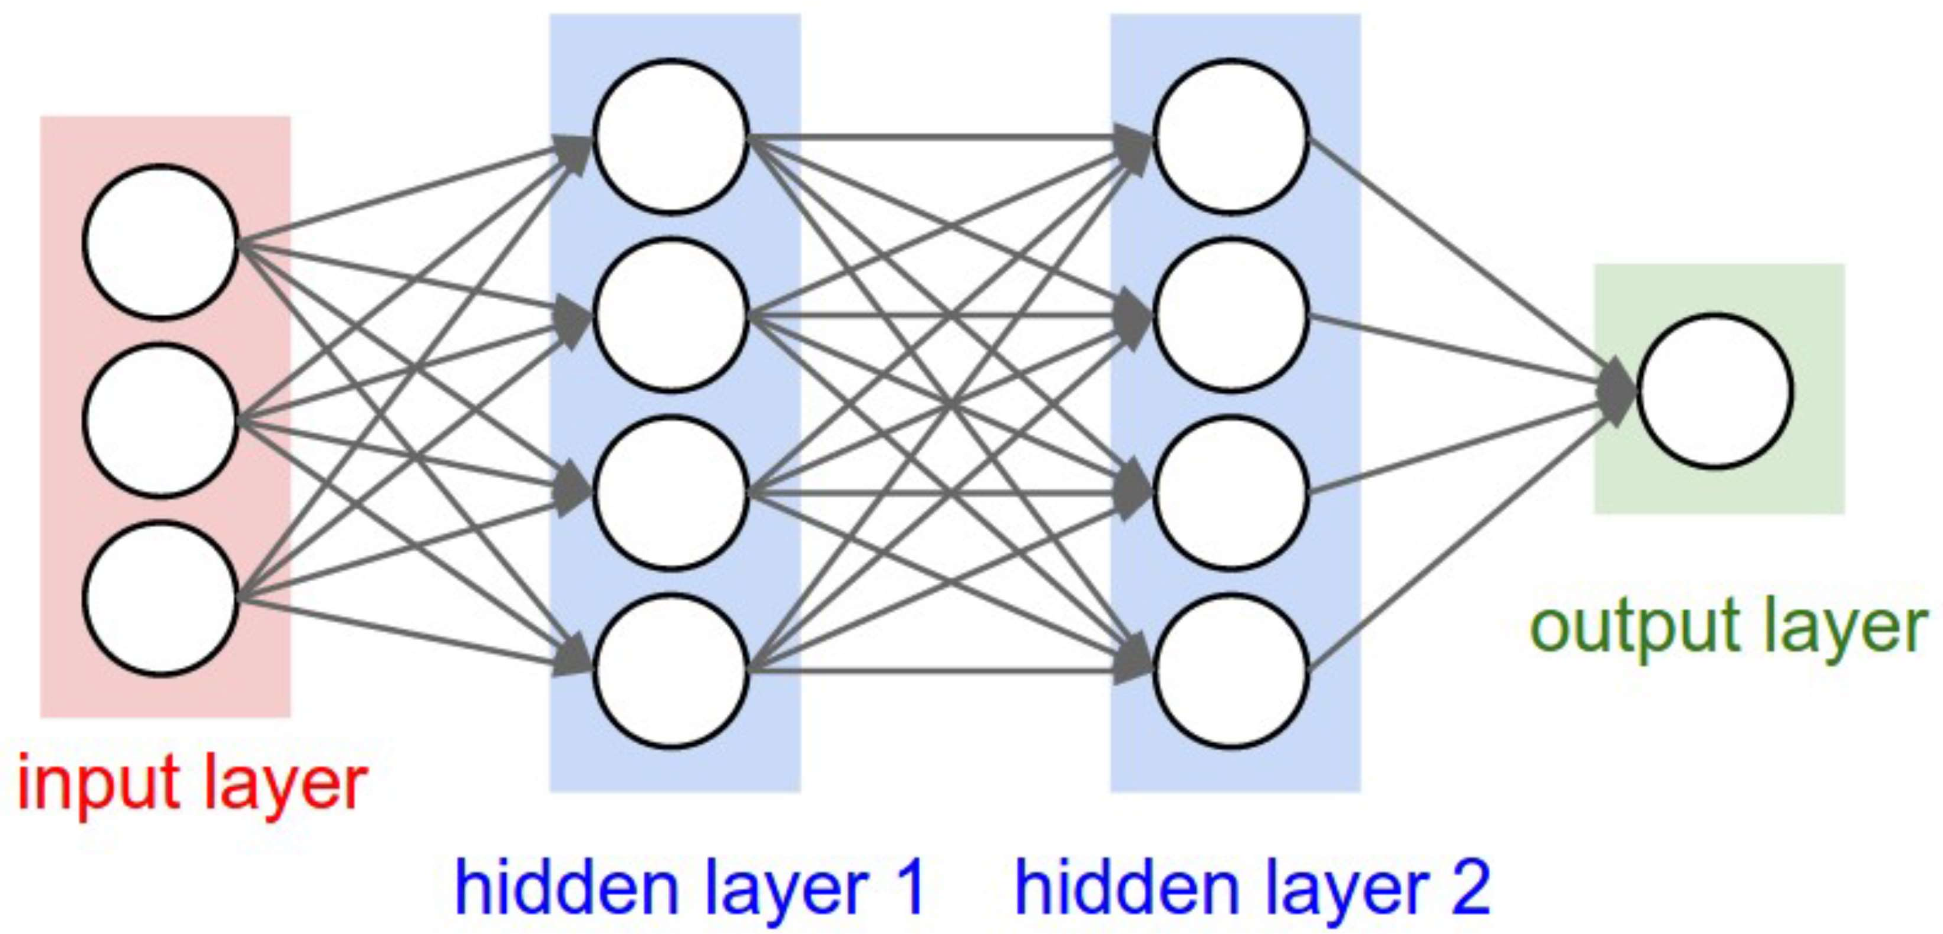
(Shallow) Neural Network

Slide 54
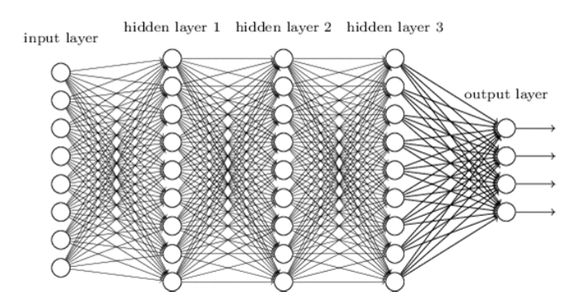
Deep Neural Network
input layer
output layer
hidden layer 1
hidden layer 2
hidden layer 3

Slide 55








Slide 56


Slide 57




Slide 58






Slide 59






Slide 60







Slide 61




Slide 62





Slide 63





Slide 64

Deep Learning

Slide 65










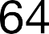





Slide 66

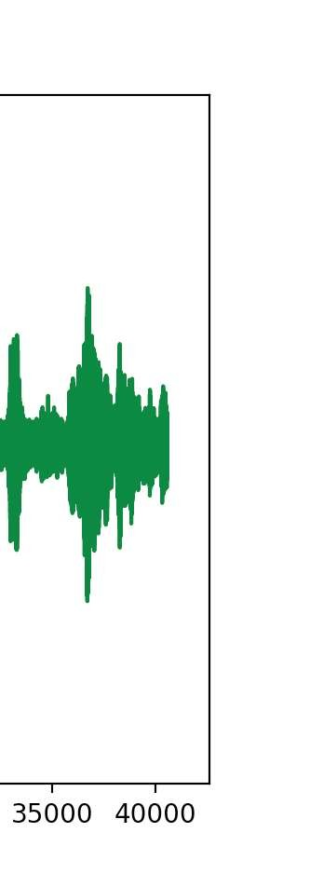

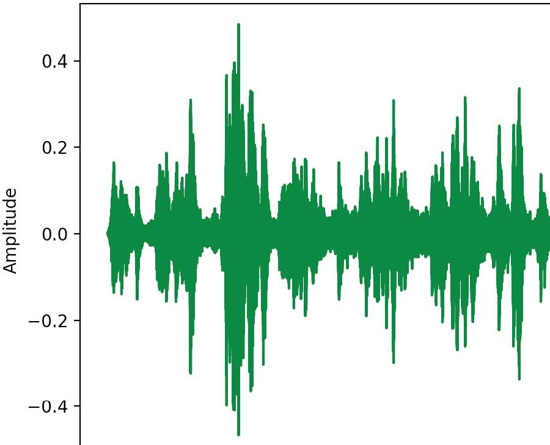
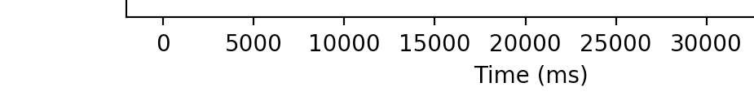




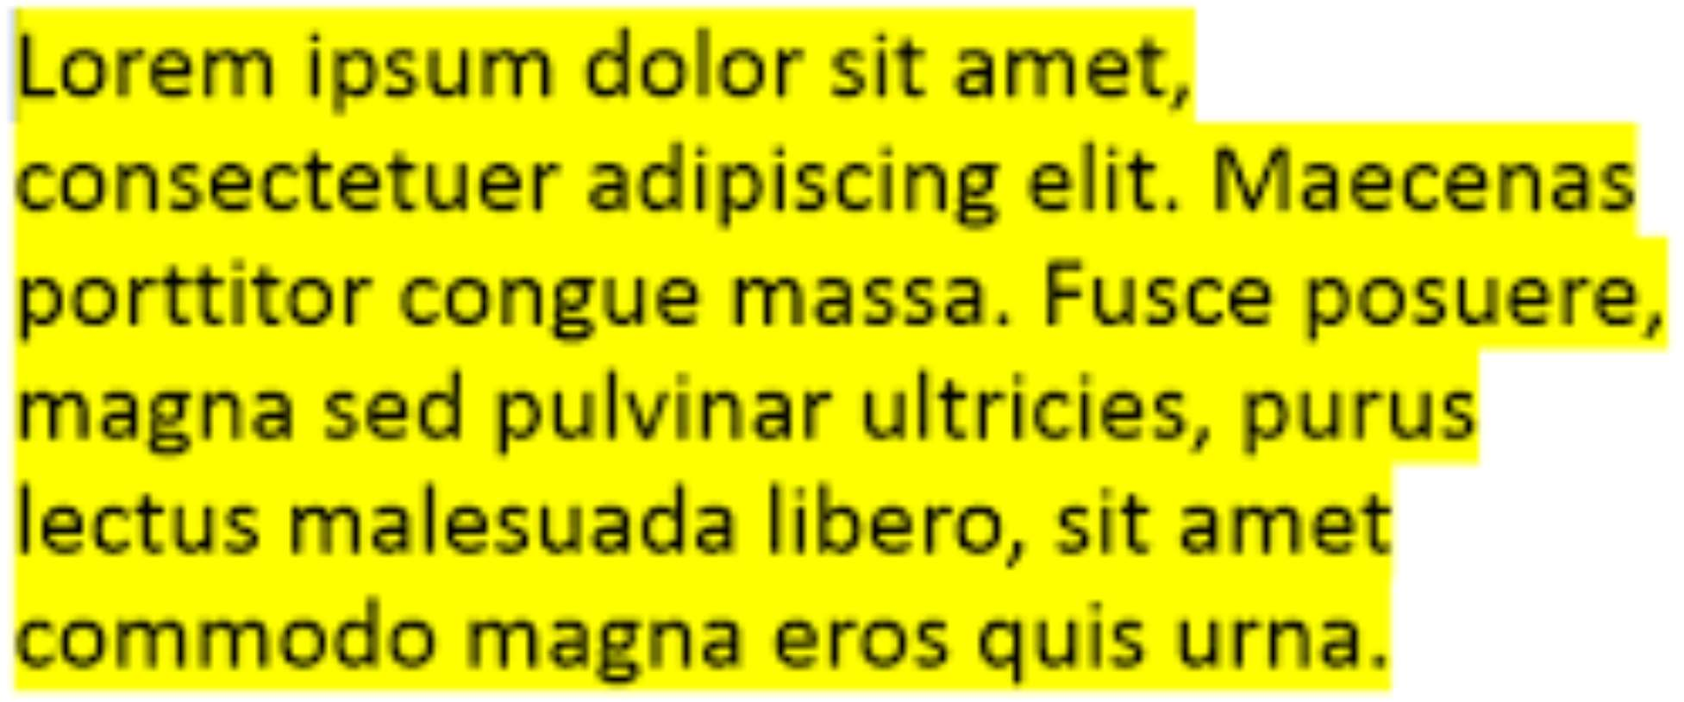



Slide 67
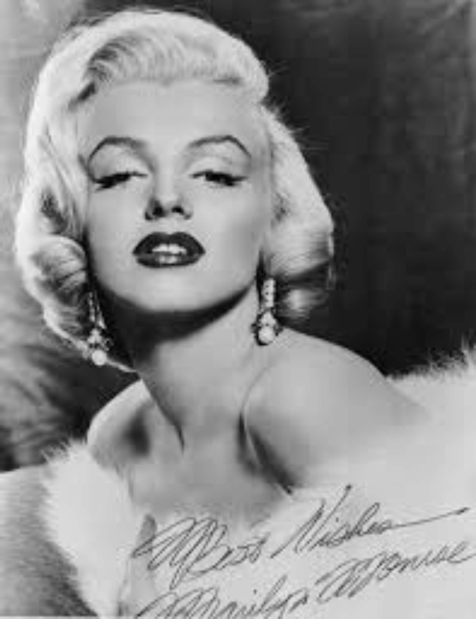

Slide 68


Slide 69


Slide 70


Slide 71
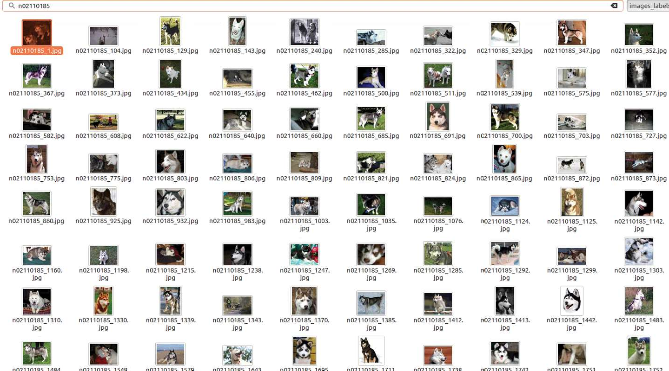

Slide 72
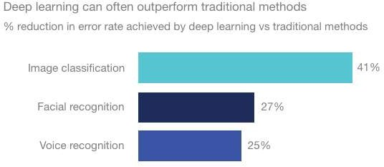




Slide 73





















Slide 75


Slide 76
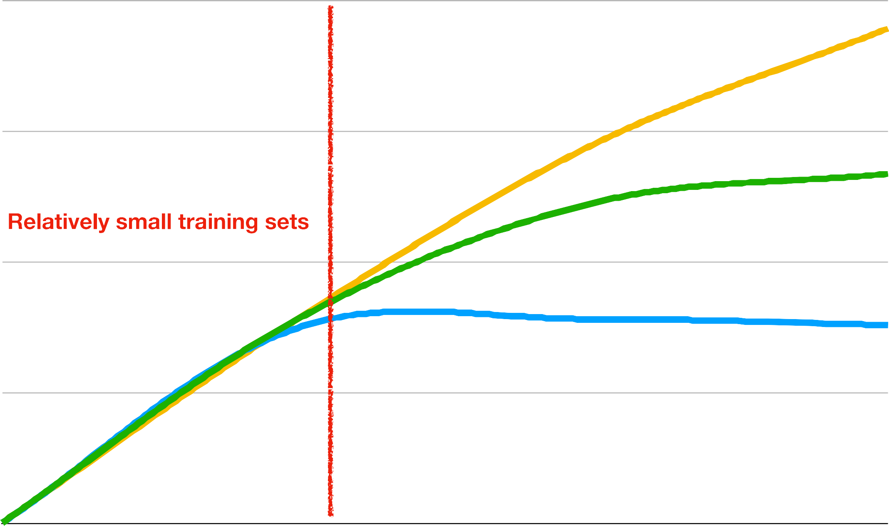




Slide 77
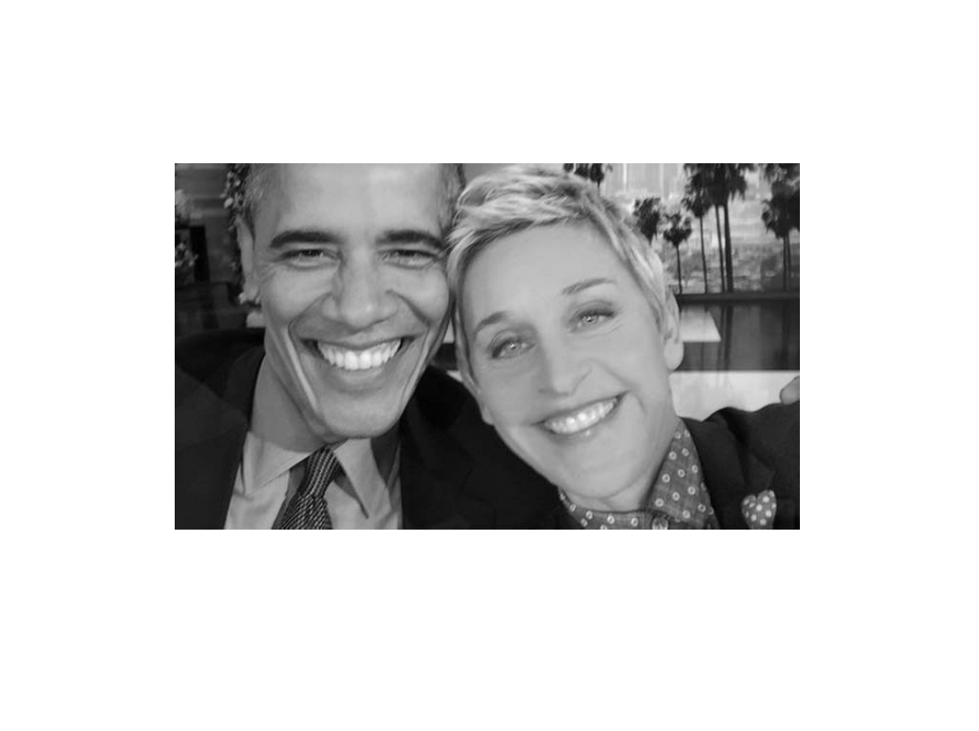

Slide 78
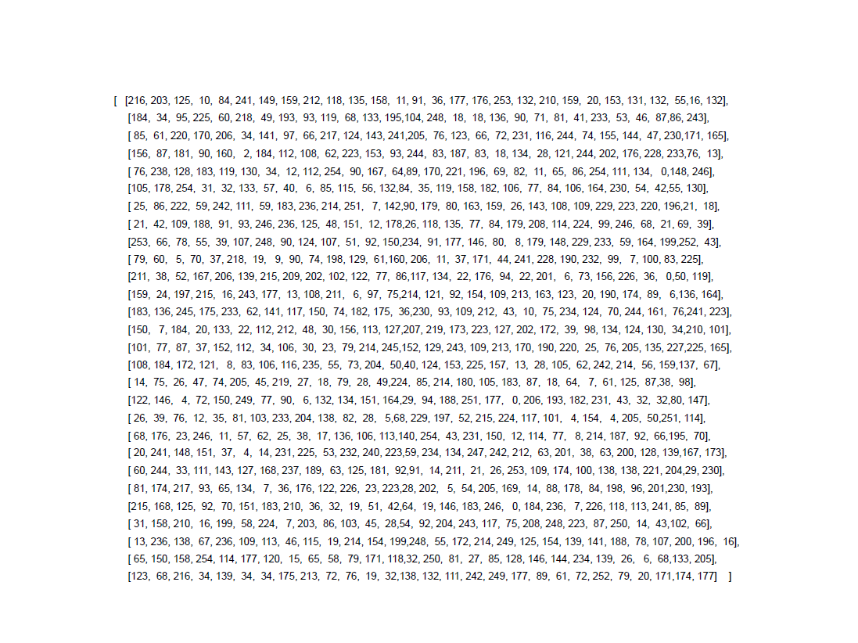

Slide 79


Slide 80
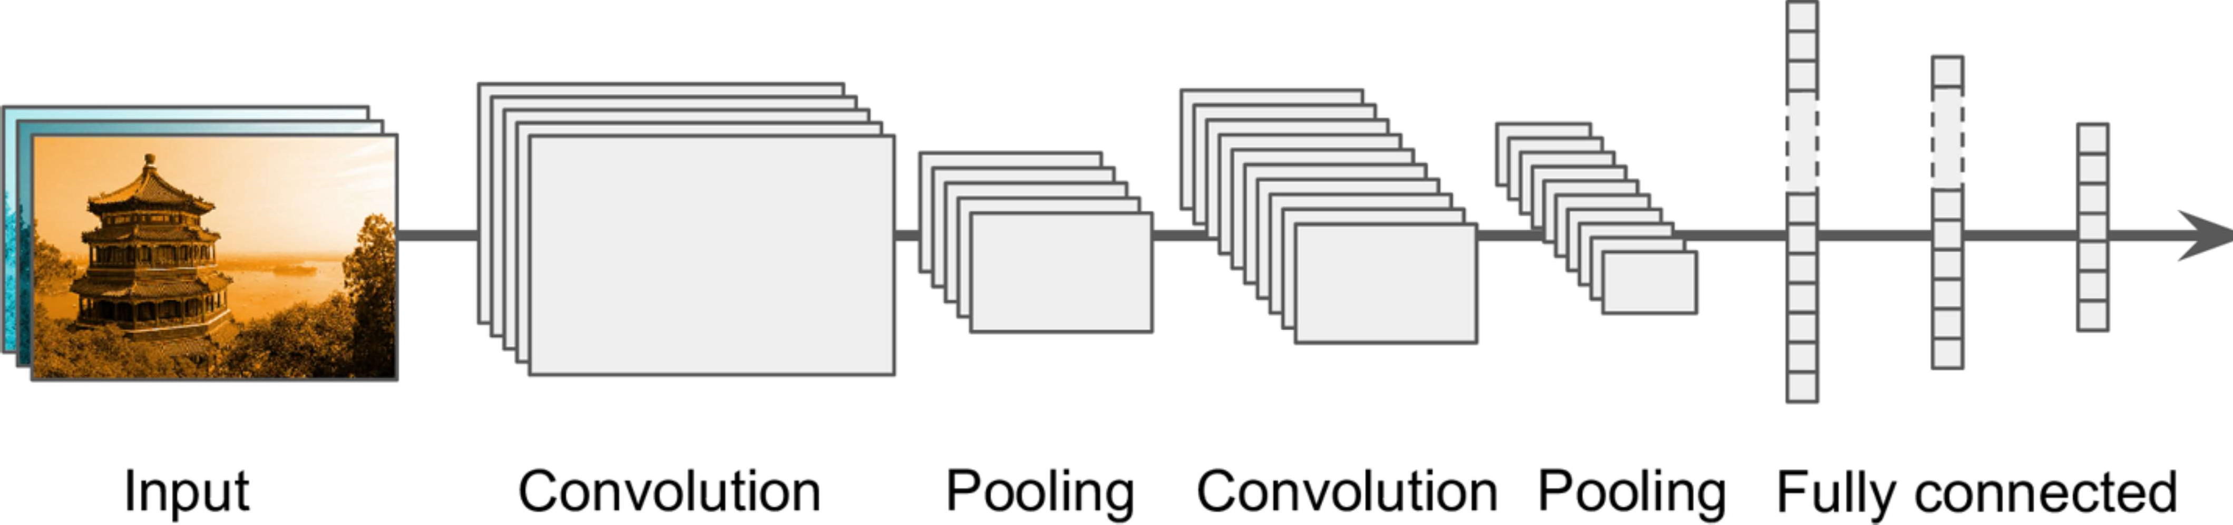
Convolutional Neural Network

Slide 81
Convolutional Neural Network

Slide 84
WIDTH

Slide 85
HEIGHT
WIDTH

Slide 86
HEIGHT
WIDTH
DEPTH

Slide 97
Feature Map

Slide 103
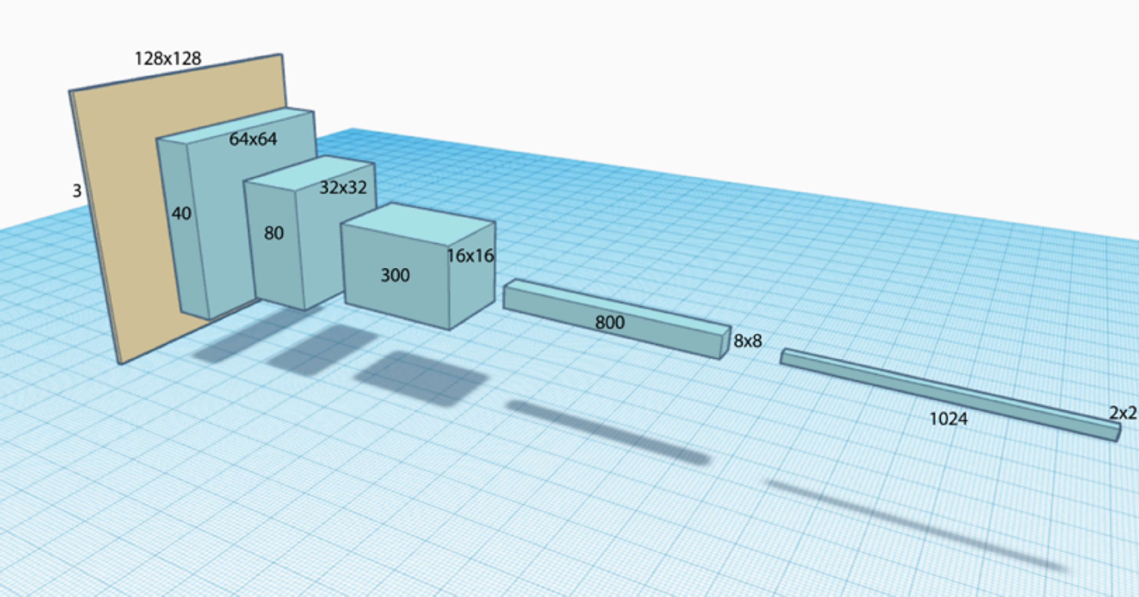


Slide 104
